Slide 1
Introduction to Rguroo
BIOSTAT 201A Fall 2025
Discussion 1 - October , 2025
Slides by Cindy J. Pang

Slide 2
Outline
Access Rguroo
Rguroo Demo
Rguroo Exercise

Slide 3
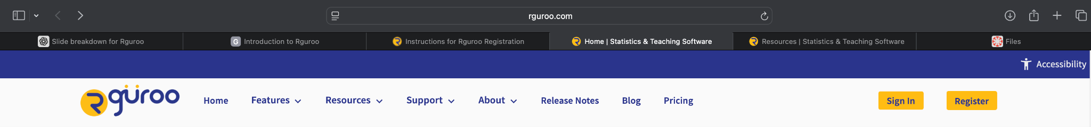
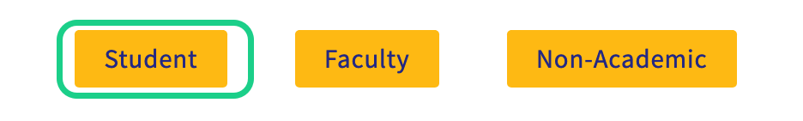
Step 1: Rguroo Registration
Go to rguroo.com → click Register
Select the ‘Student’ Option.

Slide 4
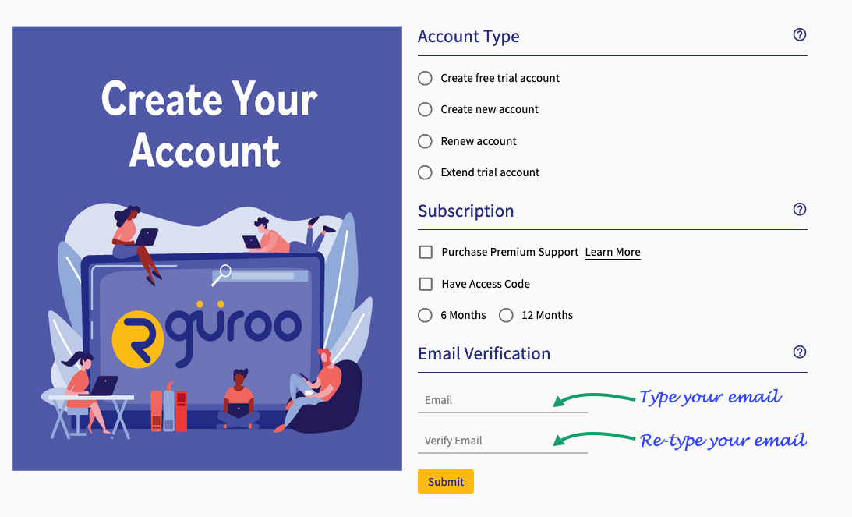
Step 2: Rguroo Account Creation
joebruin@ucla.edu
with your @ucla.edu email
NOT with @g.ucla.edu or @mednet.ucla.edu

Slide 5
Outline
Access Rguroo
Rguroo Demo
Rguroo Exercise

Slide 6
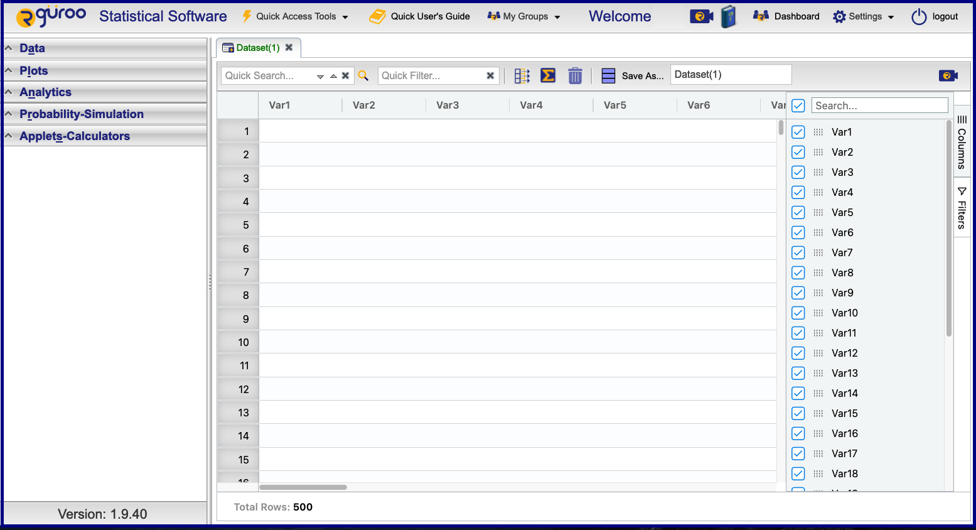
Rguroo Interface
Notes:
This is the Rguroo Interface.
On the left, you can create datasets, plots, output reports, use a calculator, and more.
[show students Quick Access Features]
You can also click into “Quick Access Tools” to quickly Import a Datasets, use a Scientific Calculator, pull up Shortcut Keys, look at available datasets in Repository Datasets, and if you know R, you can execute your R code in “Execute R Code”. Note that there are keyboard shortcuts for all of these tools.
[transition to talking about the User Interface; show students these features]
If you forgot what I did in today’s tutorial, you can access help for using Rguroo using “Quick User’s Guide”. This tool contains tutorials for data analysis, importing data accessing data and data visualization.

Slide 7
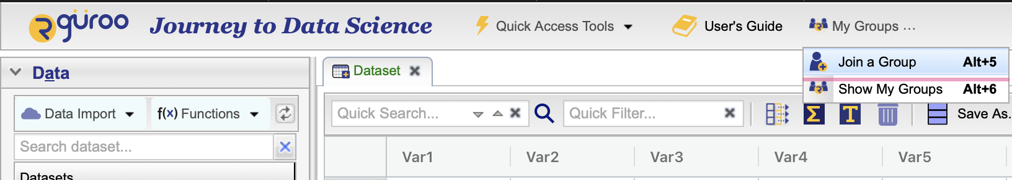
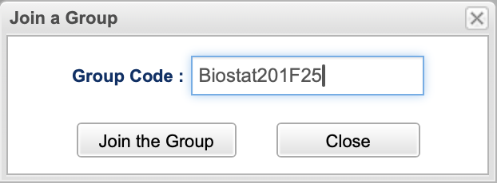
Join Rguroo Group
Notes:
Now, we are going to join our Class group.
On the top bar, click My Groups > Join a Group. The Group Code is “Biostat201F25”

Slide 8
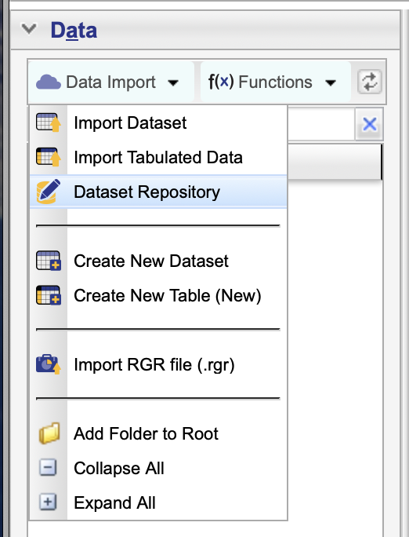
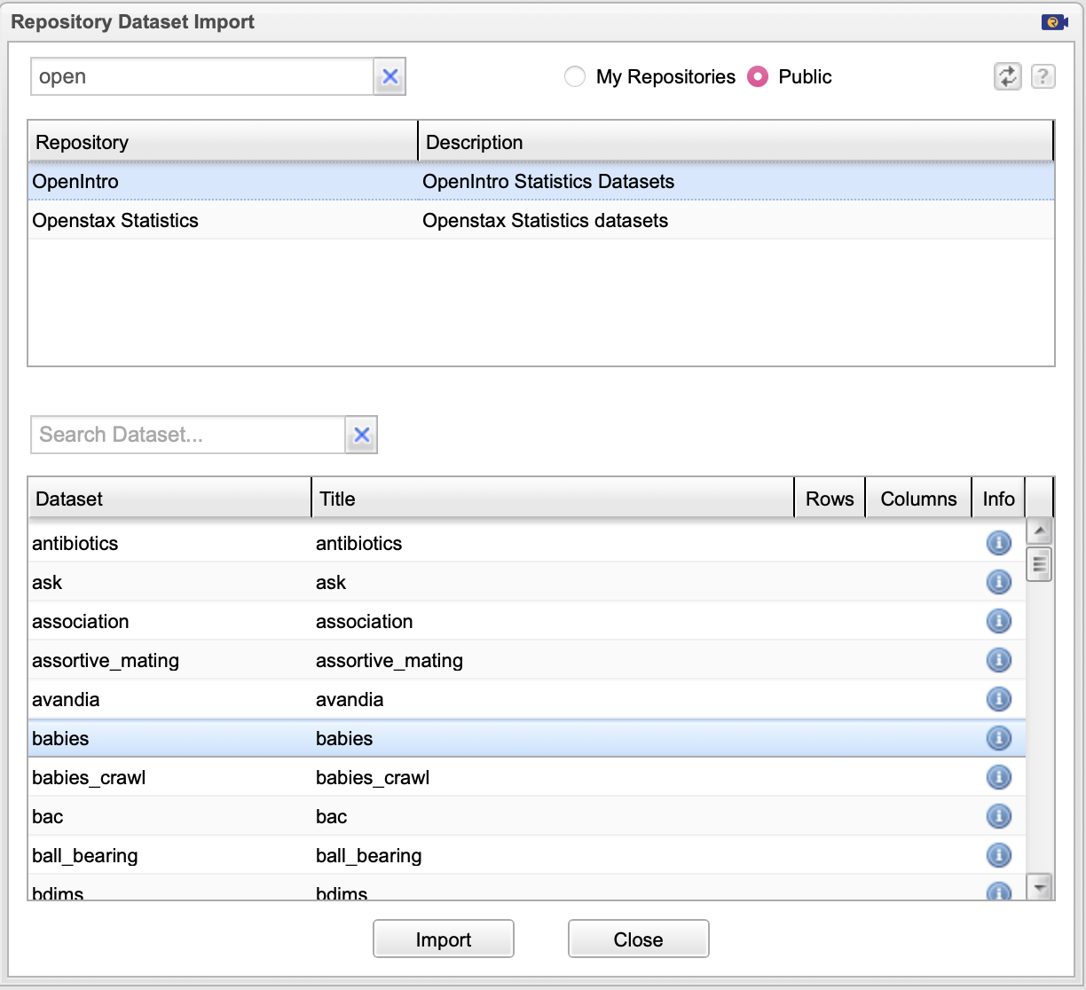
Accessing Rguroo Dataset
Repository Search Bar
Notes:
To load the babies dataset, go into the “Data” tab on the left and click “Dataset Repository” since we are loading a pre-existing dataset in the Rguroo database.
Then, using the search box, type in “OpenIntro” since the dataset we are interested in is in that repository. Finally, you can see the babies dataset.

Slide 9
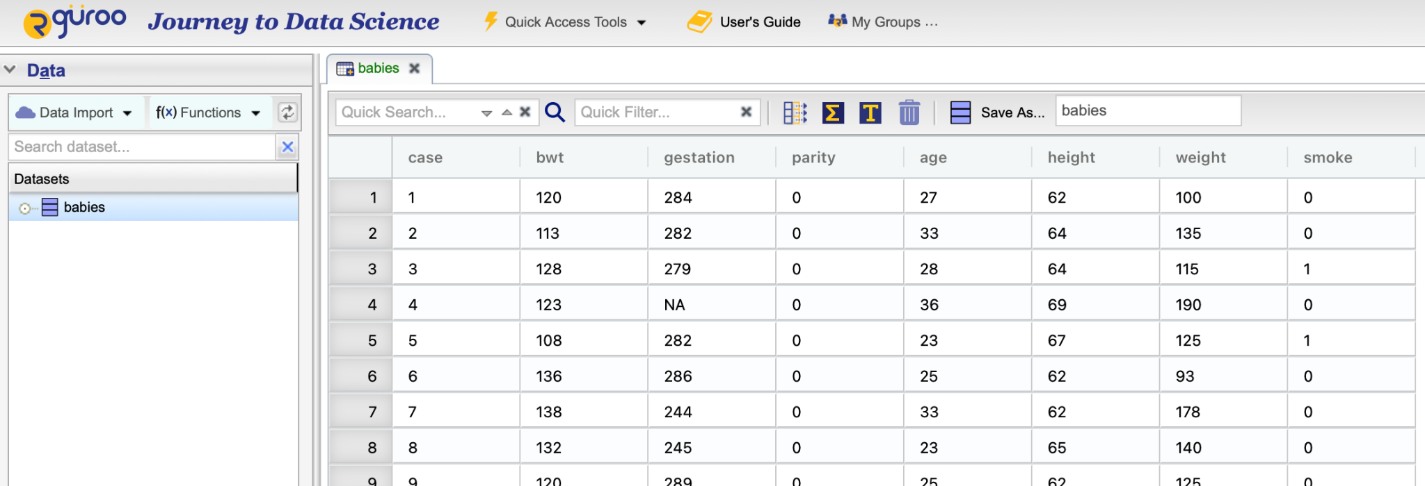
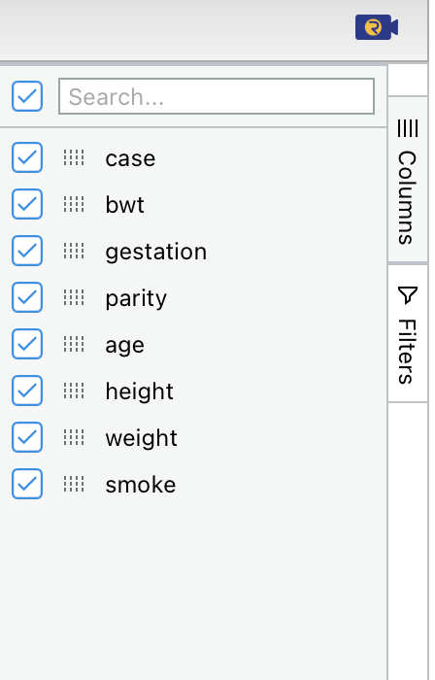
Opening a Dataset
Double-click to open dataset
Exercise: Filter the data to age, height, and weight
Select the variables you want to view
Notes:
On the left, you can see where you’ve imported the dataset. Double click to open this dataset and it should pop up on the main window.
On the right, select the variables you want to view.
As an exercise, let’s filter the data to age, height, and weight since these will be the variables we care about for data exploration.

Slide 10
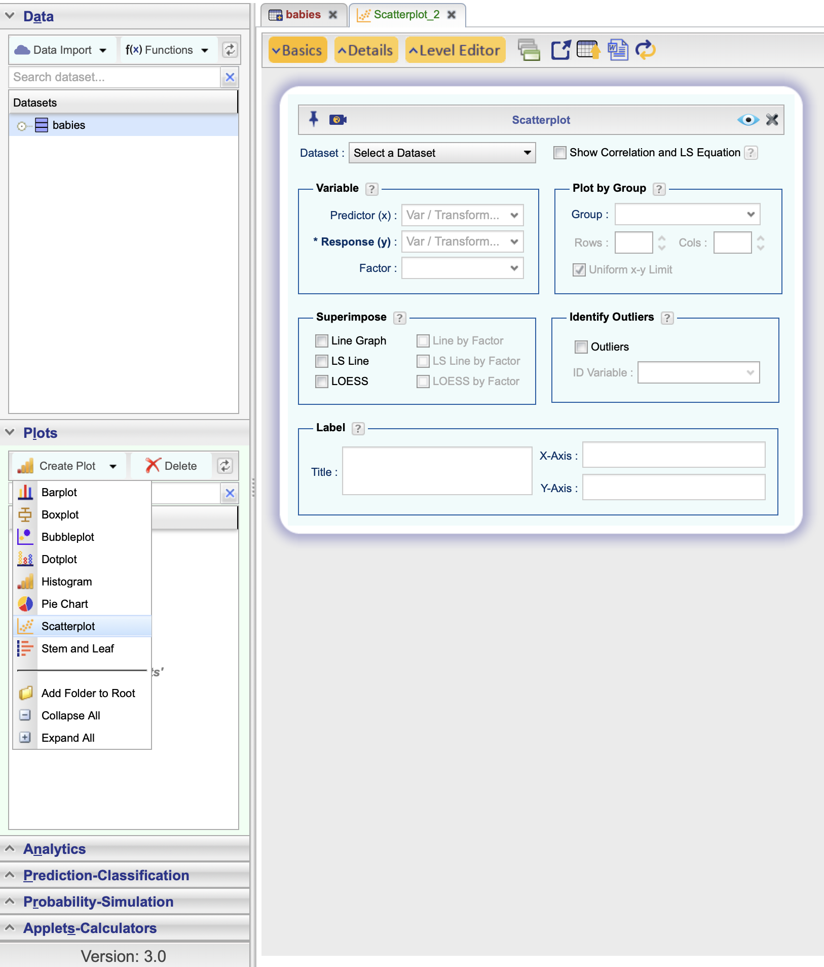
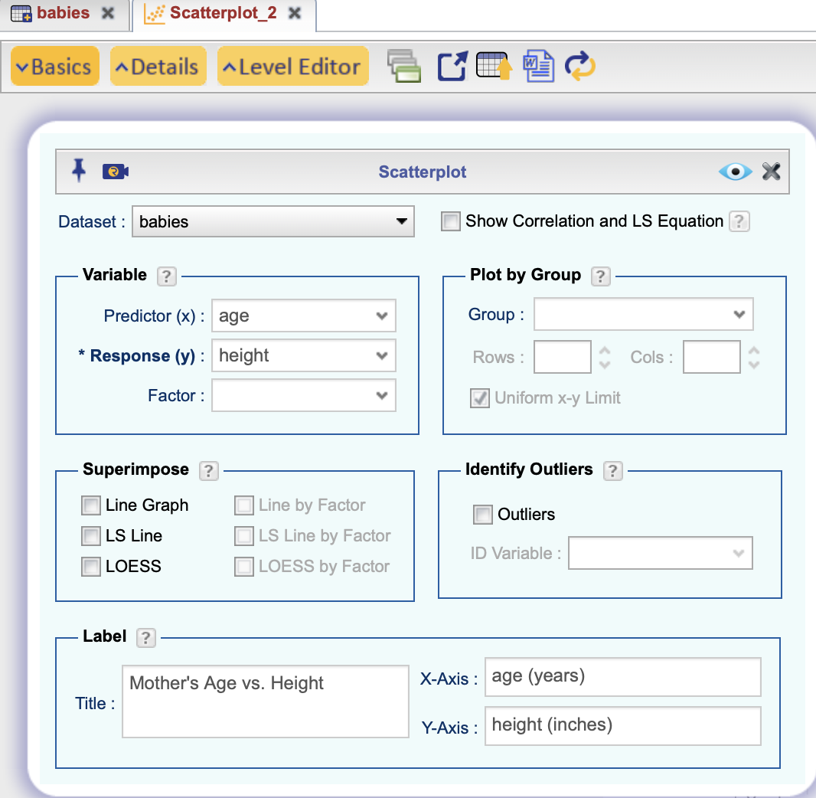
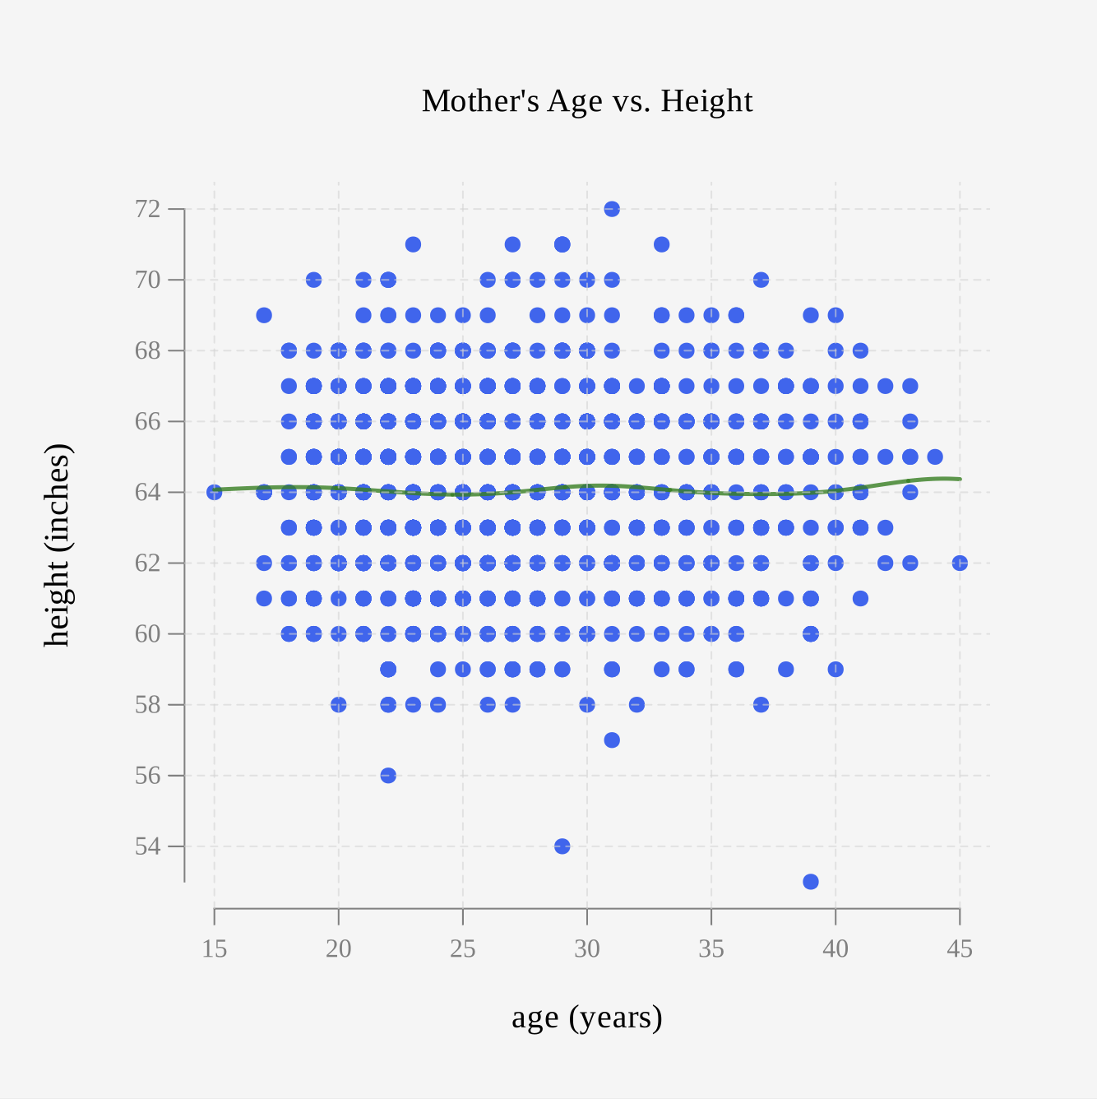
Data Visualization
Click to View Plot
Notes:
Now that we’ve filtered the data to the variables we care about, let’s plot the age vs. the height.
To make a plot, you can go to the left panel and click “Plots” and then “Create Plot”. Then you’ll have options of what kinds of plots you can create. For this demo, I’m going to create a scatter plot, where our independent variable is “age” in years and dependent variable is “height” in inches.
To put data onto the scatterplot, you click Basics to define the variables you want to plot. You can also Superimpose lines and Label your Axes. Finally, to see your plot, hit the eye to see your work.
After you are done creating your plot, save it so you can access it later.

Slide 11
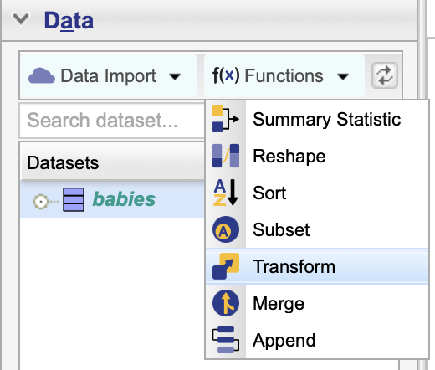
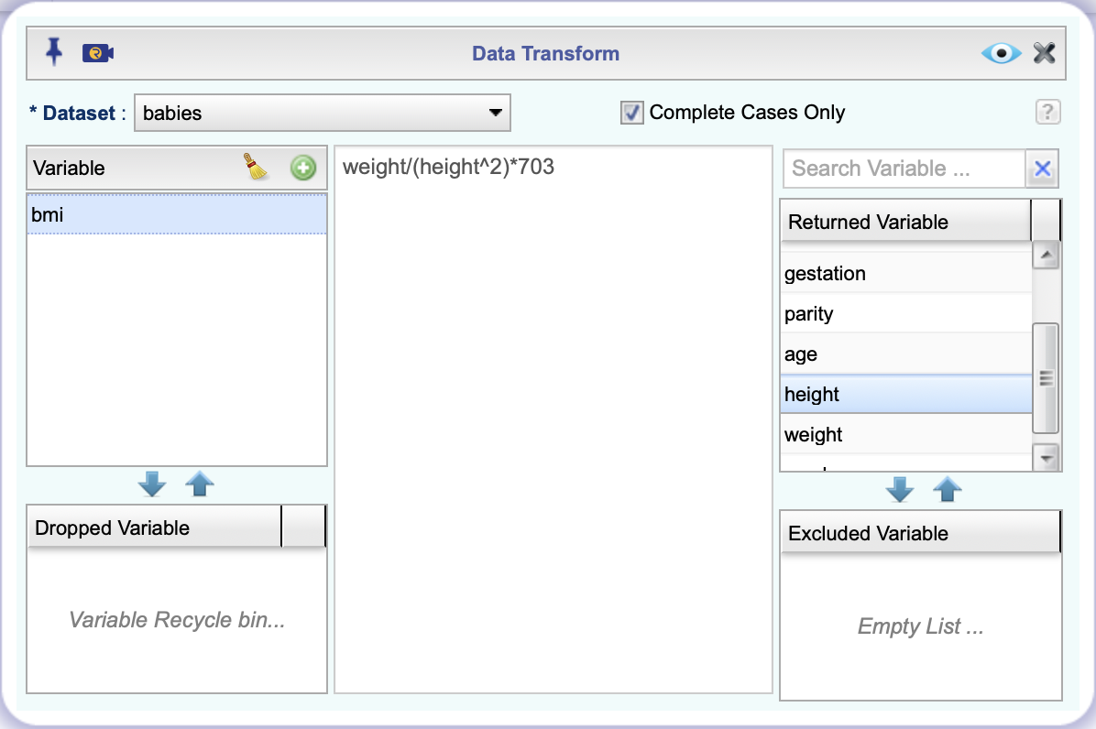
Add Variables to the Dataframe
Click to see new data frame
Notes:
To add a variable to the dataframe, go back to the “Data” tab and hit “Functions”. Here, there is a wide range of things you can do that allows you to organize and transform your data frame. For example, you can create summary statistics for variables, sort a column alphabetically, find values in a column within a certain range, etc.
I will create the BMI variable. So first, load the dataset, and then hit the green plus sign to make a new variable. Then you can use the variables in “Returned Variable” to create the equation for new variable

Slide 12
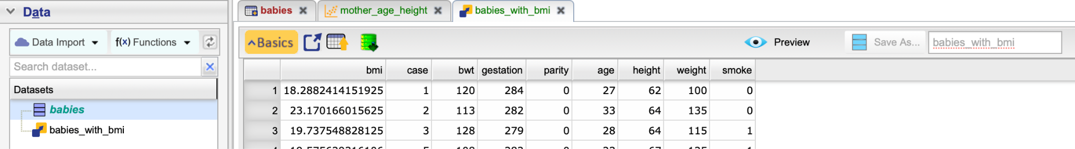
Saving Your Dataframe
Save the new dataframe
Notes:
With the new variable you’ve created, you can save this new dataframe. I saved mine as “babies_with_bmi”. The newly created dataset is in the Datasets tab.

Slide 13
Outline
Access Rguroo
Rguroo Demo
Rguroo Exercise (see student guide)

